Slide 1
CSE 524 Advanced Project

Slide 2
Mitesh Jalan
Mortality Risk Prediction

Slide 3
Replication of Research Paper
Lyu, W., Dong, X., Wong, R., Zheng, S., Abell-Hart, K., Wang, F., & Chen, C. (2023). A Multimodal Transformer: Fusing Clinical Notes with Structured EHR Data for Interpretable In-Hospital Mortality Prediction. AMIA Annu Symp Proc. 2023 Apr 29;2022:719-728. PMID: 37128451; PMCID: PMC10148371.

Slide 4
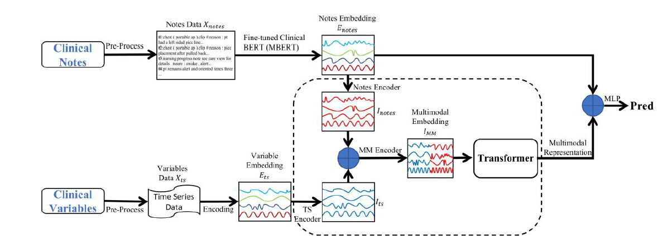
Workflow of the Paper

Slide 5
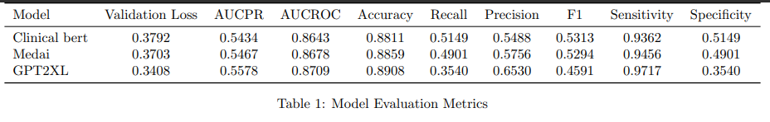
Experiments with different LLM models
Clinical Bert is the one used in the paper.(still has the best F1 but less in some metrics.)

Slide 6
Experiment with OpenAI GPT4 (Azure)
This task is not possible with GPT4 API as the output is nonconclusive in mortality prediction.
Output:
Based on the provided information, it is difficult to determine with certainty whether the patient is at risk of death. The clinical notes mention various medical conditions and procedures, as well as abnormalities observed in imaging scans, which may indicate underlying health issues. However, without additional context or information about the patient's overall health status, it is not possible to make a conclusive assessment of their mortality risk. Therefore, a more detailed evaluation of the patient's medical history and current condition is necessary to provide a reliable prediction of their outcome.

Slide 7
Implementation Code
GPT-4 experiment:
CSE-524-Mortality-risk-prediction/GPT4 Azure/GPT4-azure.ipynb at main · MiteshJalan/CSE-524-Mortality-risk-prediction (github.com)

Slide 8
Thank You

